Slide 1
The halting problem A journey through Alan Turing's seminal paper

Slide 2
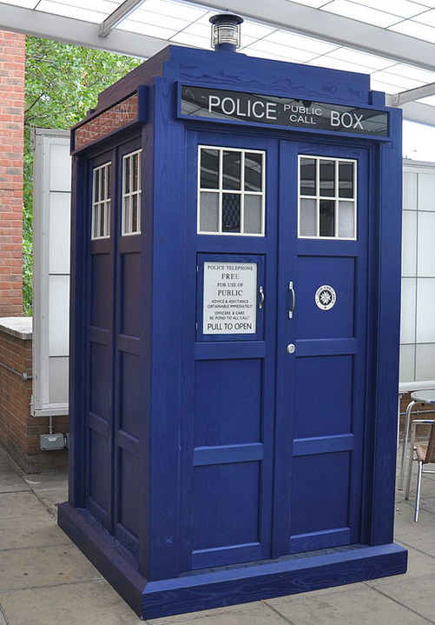
Time travel back to 1936
The IV Olympic Winter Games opened in Germany
The Italian invasion of Abyssinia (Ethiopia)
The Coronation of King George VI and Queen Elizabeth
The Spanish Civil War began
New Zealand conducted a census: the population was approximately 1,573,812, with 50.7% male and 49.3% female
The merger of the United and Reform parties formed the National party
The Australian rugby team toured NZ. The All Blacks won both test matches and regained the Bledisloe Cup

Slide 3
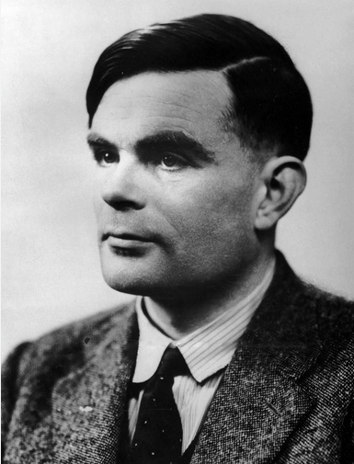
Alan Turing
Turing was educated at a top private school.
He entered the University of Cambridge to study mathematics in 1931.
After graduating in 1934, he was elected to a fellowship at King’s College in recognition of his research in probability theory.
In 1936, his seminal paper “On Computable Numbers, with an Application to the Entscheidungsproblem” was accepted for publication

Slide 4

Computer

Slide 5
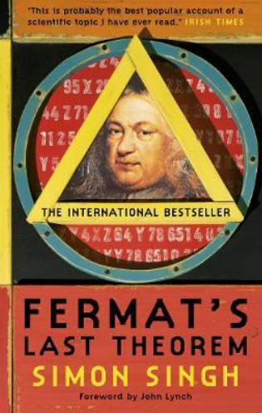
Maths problems
Fermat’s last theorem
The equation:
x**n+y**n=z**n
has no nontrivial positive integer solutions for n≥3.
3**2 + 4**2 = 5**2
Solved in 1995

Slide 6
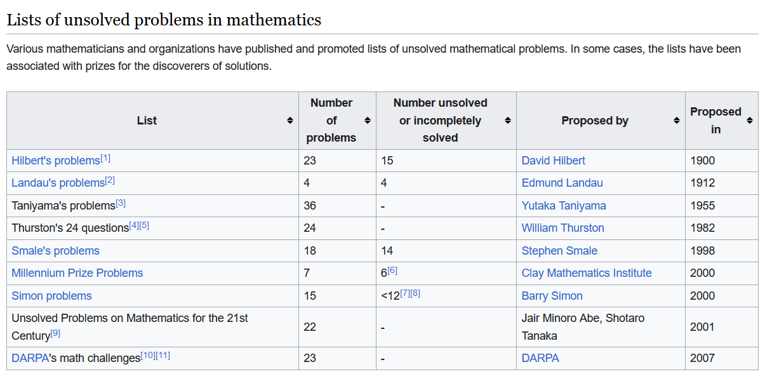
Maths problems yet to be solved

Slide 7
Axioms
An axiom is a fundamental statement or proposition that is accepted as true without requiring proof.
Axioms are considered self-evident or universally accepted, forming the foundation upon which other truths and theorems are built.
e.g. two sets are equal if and only if they have the same elements
Euclid – Elements – first printed in 1482 - built a series of axioms or postulates.
Start with simple axioms and then use the axioms to prove more complicated procedures – rinse and repeat

Slide 8
Entscheidungsproblem
Hilbert's axiomatic foundations of mathematics (circa 1900):
Axioms should be consistent – there are no statements that could be proven to be both true and false
Axioms should be complete – every statement should be able to be proved or disproved from the axioms

Slide 9
Entscheidungsproblem
The Entscheidungsproblem – there should be a decision procedure that can tell us if a statement can be proved from the axioms
By decision procedure, he meant a clear computational process, i.e., an algorithm that would start with the axioms and a potential conclusion and tell us if the conclusion could be proved by the axioms.
Hilbert was certain that such an algorithm existed. The Entscheidungsproblem (decision problem) was the problem of finding the algorithm.
Hilbert didn’t define what he meant by “decision procedure“.

Slide 10
Entscheidungsproblem
The Entscheidungsproblem sought an effective method for solving the fundamental mathematical problem of determining exactly which mathematical statements are provable within a given formal mathematical system and which are not.

Slide 11
Entscheidungsproblem
Decision procedure ~ algorithm
Can an algorithm decide if another algorithm will stop?
Turing’s insight was to define algorithms in terms of theoretical machines.
Can a Turing machine decide if another Turing machine will stop?
This is the topic of Turing’s paper

Slide 12
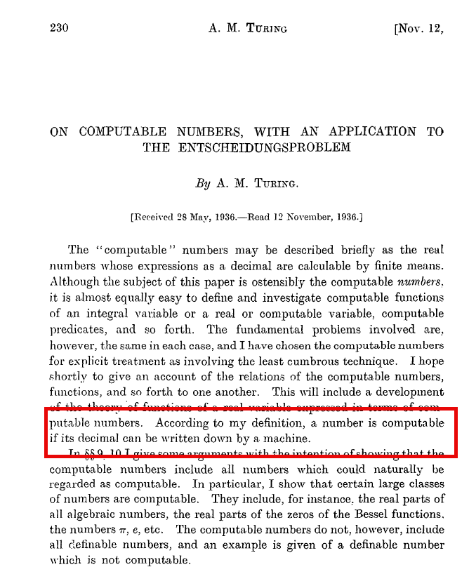
On computable numbers
A computable number [is] one for which there is a Turing machine which, given n on its initial tape, terminates with the nth digit of that number [encoded on its tape].
36 pages 372 pages

Slide 13
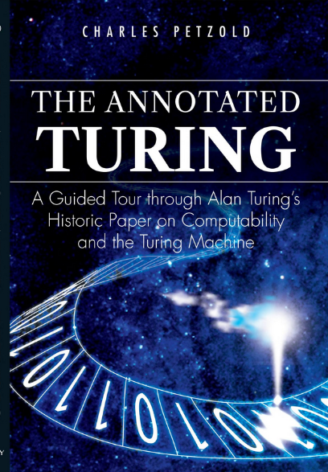
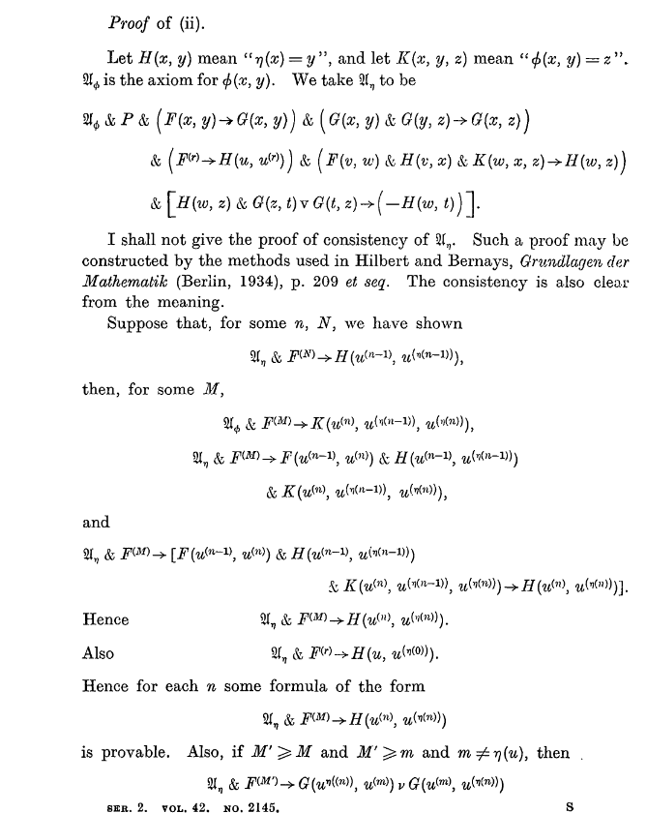
On computable numbers
36 pages 372 pages

Slide 14
Diagrammatic representation of FSM
head
…
@
0
0
1
¹
#
. . .
Finite control
Read/write input tape

Slide 15
Finite state machine
Finite state machine – processes the input and halts at the end.
The input string is accepted if it halts in an accept state.
Rejected if it halts in a non-accept state.
Finite string, reads from left to right, no write, the machine halts an end of the string.
They have only a finite number of states.
The number may be large, but it is still finite.
The only way they can remember something is to go to a new state.

Slide 16
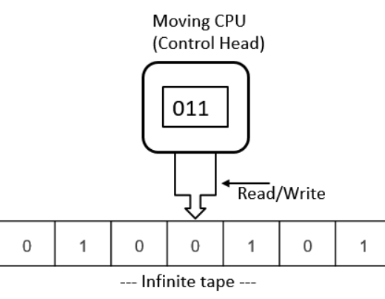
Diagrammatic representation of a TM

Slide 17
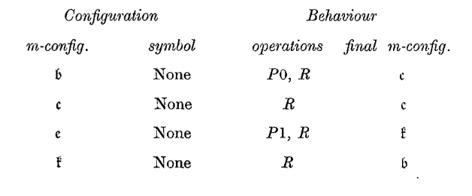
Turing machine
Turing machine – we can read/write and move the tape in either direction.
The Turing machine has infinite tape, reads in both directions and can write.
It halts in either an accept or reject state even if the input is not complete.
But it can loop, possibly forever, in which case it diverges.

Slide 18
Turing machine
State | Scanned square | Operation | Next state
A | Blank | P0,R | B
B | Blank | R | C
C | Blank | P1,R | D
D | Blank | R | A

Slide 19
Turing machine
FSM – can check if there are equal numbers of `(` and `)` but can‘t check if they are balanced
TM -
1 | ( | ( | ) | )
2 | ( | ( | X | )
3 | ( | X | X | )
4 | ( | X | X | X
5 | X | X | X | X

Slide 20
Palindrome
Here's a high-level description of how the Turing machine might work:
Step 1: The machine starts at the leftmost symbol of the string.
Step 2: It stores this symbol in its state and replaces it with a special symbol to mark that it has been read.
Step 3: The machine moves right until it encounters the rightmost symbol of the string.
Step 4: It compares this symbol with the one stored in its state. If they are the same, it replaces the symbol with the special symbol and moves left until it encounters the next unread symbol. If they are not the same, it halts and rejects the string.
Step 5: The machine repeats Steps 2-4 until it reaches the middle of the string. If it does so without finding any mismatches, it halts and accepts the string.

Slide 21
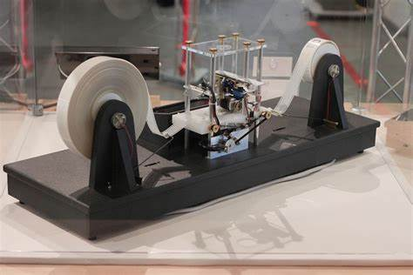
A physical Turing machine
Turing Machines and Tooling, Part I by Unknown Author is licensed under CC BY-SA

Slide 22
A simple machine
0
B
1
A

Slide 23
Slightly more complicated – odd number of 1’s
00R
11R
00R
##R
A
B
C
11R

Slide 24
Encoding – strings that end with 01
1
1
0
0
0
1
2
3
1

Slide 25
Encoding
1111 = Start / end
111 = End of category ~period
11 = Change of sub category ~ semicolon
1 ~ comma
Number of states
Accepting states number
Encoding of states – input → state
1111
000 111 No. of states
000 111 Accepting state
State 1 0010 11
0 input goto state 2, 1 input goto state 1
State 2 001000 11
0 input goto state 2, 1 input goto state 3
State 3 0010
0 input goto state 2, 1 input goto state 1
1111
Encoding:
1111000111000111001011001001100101111

Slide 26
Universal Turing machine
For a machine M and an input I we can write it as (M,I) where M is the encoding of a Turing Machine and I is the input
Turing called this the M configuration.

Slide 27
Universal Turing machine
M1(M1,I1)
M2(M2,I2)
M3(M3,I3)
Where the tape contains M1(M,I), M2(M,I), M3(M,I) etc.
If it can be run by a Turing machine, it can be run by a universal Turing machine.

Slide 28
Universal Turing machine
Model of a modern computer:
CPU
Some form of sequential input – move left and right
Input contains both code and data – stored program computer
Can be “programmed” so is multi-purpose
M1(M,I)
M2(M,I)
M3(M,I)

Slide 29
Reductio ad absurdum
Reductio ad absurdum is a method of argumentation that involves refuting a proposition by demonstrating an absurd outcome if the proposition is assumed true.
This method involves extending the implications of an argument to a stage of absurdity, thereby disproving the validity or common sense of the argument itself
Essentially, proof by contradiction.

Slide 30
The barber paradox
The Scenario:
Imagine a small village with a single barber.
The barber is defined as the person who shaves all those, and only those, who do not shave themselves.
The Question:
Now, consider the following question: Does the barber shave himself?

Slide 31
The barber paradox
Analysis:
If the barber shaves himself, then he must be part of the group of people he shaves (those who do not shave themselves).
But this contradicts the definition of the barber, as he should only shave those who do not shave themselves.
Conversely, if the barber does not shave himself, then he fits the criteria for being shaved by the specified barber.
In this case, he must shave himself as the barber.
Either way, we encounter a logical inconsistency.
Resolution:
The paradox reveals that no such barber can exist in reality.
The problem arises from the self-referential nature of the barber

Slide 32
The halting problem – input (M) into M
What happens if we feed M(M,I) into itself i.e. M(M,M)?
Recall the encoding of a machine that accepts strings ending in 01:
1111000111000111001011001001100101111
So this machine M(M,M) will reject the input.

Slide 33
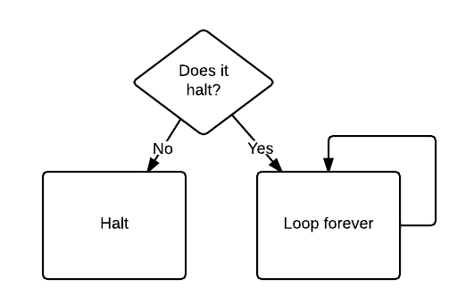
The halting problem (1)

Slide 34
The halting problem
What happens if we feed this program to itself?
If it doesn't halt, then it halts.
If it does halt, then it doesn't halt.
So, does it halt or not?
The answer is that there is no answer.
It's the computer programming equivalent of saying "I always lie":
If it's true, then it's not true, and if it's not true, then it's true.

Slide 35
The halting problem (2)
We showed a machine rejecting its own encoding.
Is there a general machine MNA which will tell us which machines do not accept their encoding?
Assume MNA exists.
Either MNA accepts (MNA), or it rejects it.
If MNA accepts (MNA), then it is a machine that accepts its encoding, but by definition, it doesn’t
If MNA does not accept (MNA) then it is a machine that does not accept its encoding, but by definition, MNA accepts encodings of machines that do not accept their encodings
MNA can’t exist

Slide 36
The halting problem (3)
ATM = {[M,w] | M is a TM and M accepts w}.
PROOF: We assume that ATM is decidable and obtain a contradiction.
Suppose that H is a decider for ATM.
On input, where M is a TM and w is a string, H halts and accepts if M accepts w.
Furthermore, H halts and rejects if M fails to accept w.
In other words, we assume that H is a TM, where
H([M,w]) = {accept if M accepts w}
= {reject if M does not accept w.}

Slide 37
The halting problem
Now we construct a new Turing machine D with H as a subroutine.
This new TM calls H to determine what M does when the input to M is its own description .
Once D has determined this information, it does the opposite.
That is, it rejects if M accepts and accepts if M does not accept.
The following is a description of D.
D = "On input [M], where M is a TM:
1. Run H on input [M, [M]].
2. Output the opposite of what H outputs; that is, if H accepts, reject and if H rejects, accept."

Slide 38
The halting problem
D([M]) = { accept if M does not accept [M]
= { reject if M accepts [M]
What happens when we run D with its own description as input?
In that case, we get:
D([D]) = {accept if D does not accept [D]
= {reject if D accepts [D]
If D(D) halts, Halt(D,D) told us that D(D) would run forever.
If D(D) runs forever, Halt(D,D) told us that D(D) would halt.
The problem arises from the self-referential nature of D[M]

Slide 39
The halting problem
Assume we have a procedure HALTS that takes as input a program P and input data D and answers yes if P halts on input D and no otherwise.
Given the program HALTS, we can construct a new (more limited) program that tests whether a program P halts when the input data is a copy of P.
procedure NEWHALTS(P);
if
HALTS(P,P) then writeln('Yes');
else
writeln('No’);

Slide 40
The halting problem
Given NEWHALTS, we can construct another program that does just the opposite of NEWHALTS:
procedure OPP(P);
if NEWHALTS(P) outputs 'Yes’
then
loop forever
else
halt;

Slide 41
HALTS – takes as input a program P and input data D and answers yes if P halts on input D and no otherwise.
procedure NEWHALTS(P);
if HALTS(P,P) then writeln('Yes');
else writeln('No’);
procedure OPP(P);
if NEWHALTS(P) outputs 'Yes’
then loop forever
else halt;
What happens when we call OPP(OPP)?
Inside OPP,
we call NEWHALTS(OPP),
which calls HALTS(OPP,OPP).
Assume HALTS(OPP,OPP) halts. So answer Yes
So NEWHALTS(OPP) has answer Yes
So OPP(P) loops
If OPP halts when fed OPP as input then the call OPP(OPP)loops forever.
If OPP doesn't halt when fed OPP as input, then the call OPP(OPP) halts.
So if OPP(OPP) halts, then OPP(OPP) loops

Slide 42
procedure NEWHALTS(P);
if HALTS(P,P) then writeln('Yes');
else writeln('No’);
procedure OPP(P);
if NEWHALTS(P) outputs 'Yes’
then loop forever
else halt;
HALTS – takes as input a program P and input data D and answers yes if P halts on input D and no otherwise.
What happens when we call OPP(OPP)?
Inside OPP,
we call NEWHALTS(OPP),
which calls HALTS(OPP,OPP).
If OPP halts when fed OPP as input then the call OPP(OPP)loops forever.
If OPP doesn't halt when fed OPP as input, then the call OPP(OPP) halts.
So if OPP(OPP) halts, then OPP(OPP) loops
OPP(OPP) can neither halt nor loop forever.
This is a contradiction! Since our only assumption was the existence of HALTS, procedure HALTS cannot exist.

Slide 43
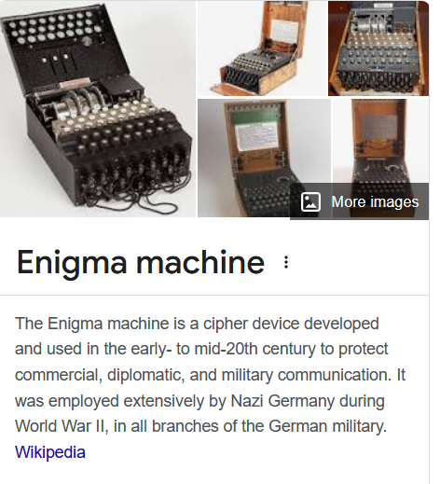
And then - Enigma

Slide 44
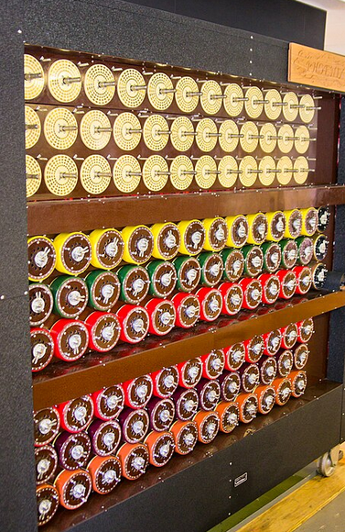
And then - Bombe

Slide 45
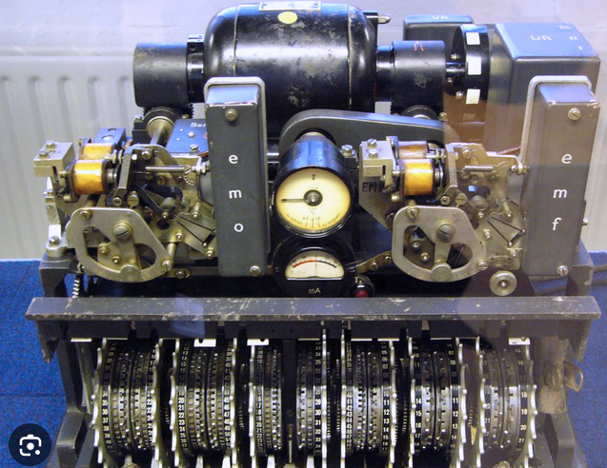
And then – Lorenz teletype

Slide 46
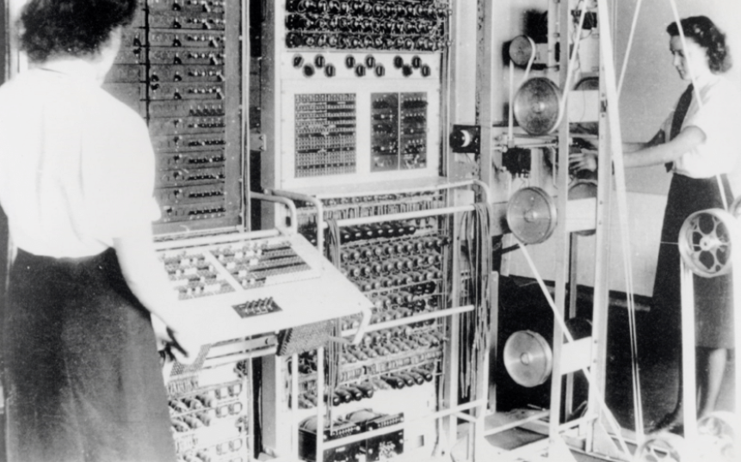
And then – Colossus Mark II
Colossus is regarded as the world's first programmable, electronic, digital computer, although it was programmed by switches and plugs and not by a stored program.
But … official secrets act!!!

Slide 47
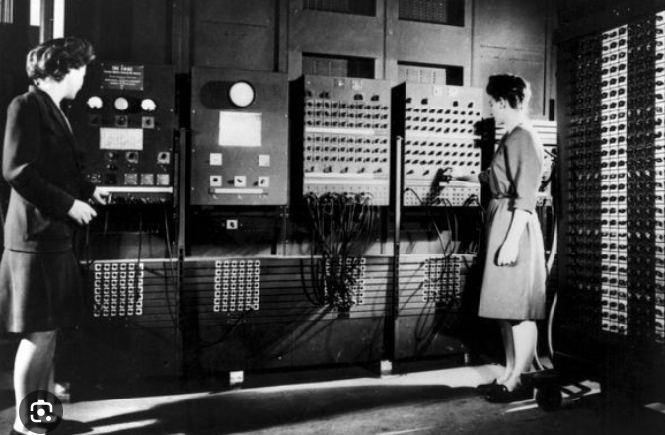
And then – ENIAC
ENIAC (Electronic Numerical Integrator and Computer) was the first programmable, electronic, digital computer, completed in 1945.

Slide 48
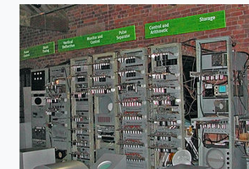
And then – Manchester baby
The Manchester Baby, was the first electronic stored-program computer. It was built at the University of Manchester and ran its first program on 21 June 1948.

Slide 49
Turing’s conviction
Alan Turing was convicted in 1952 for acts of “gross indecency” after he admitted to having a sexual relationship with a 19-year-old man.
At the time, homosexual acts were criminalized in the UK.
As a result of his conviction, Turing was banned from working for the government and was forced to undergo “chemical castration” through hormone therapy.
This conviction led to him losing his security clearance

Slide 50
Turing’s legacy
The universal Turing machine - now recognised as the foundation of computer science
Everything that can be computed on a computer can be computed by the universal Turing machine.
The claim is important because it marks out the limits of human computation.
This machine is a mathematical model of the modern computers we all use today.
He solved a mathematics problem by including engineering principles
It started the study of the theory of computation and computer science.

Slide 51
Turing’s legacy
The “old“ way emphasized statements of logic, while the new way emphasized running programs.
He introduced the stored program – where the program and data were in the same memory space
He realized that software could be used to simulate hardware e.g. arithmetic – RISC
He postulated that there are limits to computing
His insights into algorithm design and algorithmic complexity remain fundamental in computer science education
His later work was in AI, e.g., the Turing test – can machines think?

Slide 52
Alan Turing
He was convicted in 1952 of homosexuality but received a royal pardon posthumously in 2013.
ACM A. M. Turing Award is an annual prize given by the Association for Computing Machinery for contributions of lasting and major technical importance to computer science.
It is generally recognized as the highest distinction in computer science and is often referred to as the "Nobel Prize of Computing".

Slide 53
Alan Turing
Turing died in 1954
Suicide?
Poison apple?

Slide 54
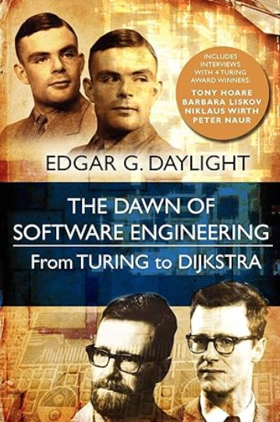
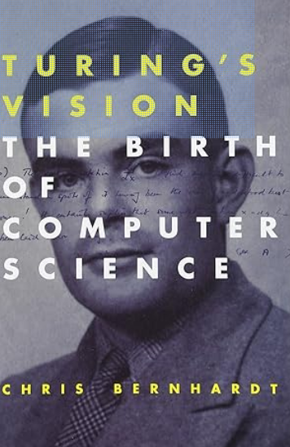

References
Wikipedia / Brilliant

Slide 55
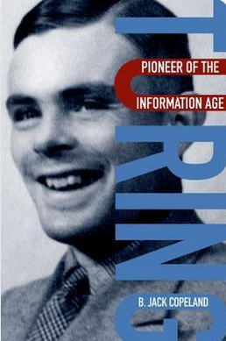
References

Slide 56
References
Good animated video of the halting problem:
https://www.youtube.com/watch?v=92WHN-pAFCs
Turing’s proof of the undecidability of the Halting problem explained in terms of phone applications
https://thorehusfeldt.com/2012/06/25/the-freeze-app-does-not-exist/
Slides:
https://rbrayb.github.io/Presentations/

